Slide 1
Non-Linear Data Structure

Slide 2
It is a form of data structure where the data elements don’t stay arranged linearly or sequentially.
Since the data structure is non-linear, it does not involve a single level. Therefore, a user can’t traverse all of its elements in a single run.

Slide 3
Type of Non-Linear Data Structure

Slide 4
Trees and Graphs are the types of non-linear data structure.

Slide 5
Trees
Tree Data Structure is a hierarchical data structure in which a collection of elements known as nodes are connected to each other via edges such that there exists exactly one path between any two nodes.

Slide 6
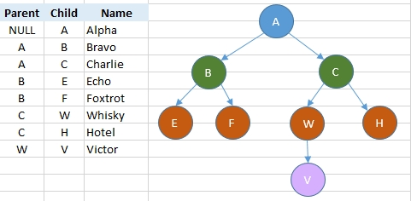

Slide 7
Properties of Trees
Root: A binary tree has a root node, which is the topmost node in the tree. It is the starting point for traversing the tree.
2. Nodes: Each node in a binary tree has at most two children, referred to as the left child and the right child.
3. Number of edges: An edge can be defined as the connection between two nodes. If a tree has N nodes then it will have (N-1) edges.

Slide 8
4. Depth of a node: The depth of a node is defined as the length of the path from the root to that node. Each edge adds 1 unit of length to the path. So, it can also be defined as the number of edges in the path from the root of the tree to the node.
5. Height of a node: The height of a node can be defined as the length of the longest path from the node to a leaf node of the tree.
6. Leaves: Nodes without any children are called leaves or leaf nodes. In a binary tree, leaves are the nodes with no left or right child.

Slide 9
7. Subtrees: A binary tree is composed of subtrees. A subtree is a tree formed by selecting a node and all its descendants, including the node itself.
Degree: The degree of a node is the number of children it has. In a binary tree, nodes have a degree of at most 2.
Balanced Binary Tree: A binary tree is considered balanced if the height of the left
Full Binary Tree: A binary tree is full if each node has either 0 or 2 children. In other words, every node is either a leaf or has two children. and right subtrees of any node differ by at most one.

Slide 10
11. Complete Binary Tree: A binary tree is complete if all levels, except possibly the last, are completely filled, and all nodes are as left as possible.
These properties provide a foundation for understanding and working with binary trees in various algorithms and applications, such as searching, sorting, and hierarchical data representation.

Slide 11
Application of Tree Data Structure
File System: This allows for efficient navigation and organization of files.
Data Compression: Huffman coding is a popular technique for data compression that involves constructing a binary tree where the leaves represent characters and their frequency of occurrence. The resulting tree is used to encode the data in a way that minimizes the amount of storage required.

Slide 12
Compiler Design: In compiler design, a syntax tree is used to represent the structure of a program.
Database Indexing: B-trees and other tree structures are used in database indexing to efficiently search for and retrieve data.

Slide 13
Advantages of Tree
Tree offer Efficient Searching Depending on the type of tree, with average search times of O(log n) for balanced trees like AVL.
Trees provide a hierarchical representation of data, making it easy to organize and navigate large amounts of information.
The recursive nature of trees makes them easy to traverse and manipulate using recursive algorithms.

Slide 14
Disadvantages of Tree
Unbalanced Trees, meaning that the height of the tree is skewed towards one side, which can lead to inefficient search times.
Trees demand more memory space requirements than some other data structures like arrays and linked lists, especially if the tree is very large.
The implementation and manipulation of trees can be complex and require a good understanding of the algorithms.

Slide 15
Types of Tree
Binary Tree
Binary Search Tree
AVL Tree
B-Tree

Slide 16
Binary Tree
A binary tree is a tree data structure in which each parent node can have at most two children. Each node of a binary tree consists of three items:
data item
address of left child
address of right child

Slide 17
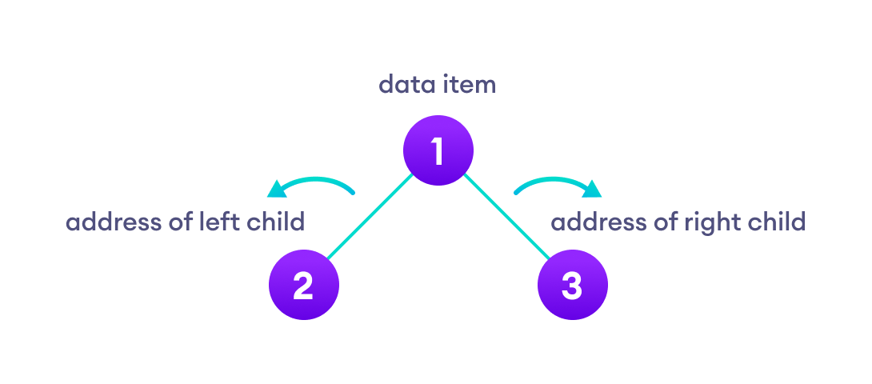

Slide 18
Application of Binary Trees
Game AI: Binary trees can be used to implement game AI, where each node represents a possible move in the game. The AI algorithm can search the tree to find the best possible move.
Database systems: Binary trees can be used to store data in a database system, with each node representing a record. This allows for efficient search operations and enables the database system to handle large amounts of data.
Decision trees: Binary trees can be used to implement decision trees, a type of machine learning algorithm used for classification and regression analysis.

Slide 19
Binary Search Tree
A binary Search Tree is a node-based binary tree data structure that has the following properties:
The left subtree of a node contains only nodes with keys lesser than the node’s key.
The right subtree of a node contains only nodes with keys greater than the node’s key.
The left and right subtree each must also be a binary search tree.

Slide 20
Real-time applications of Binary Trees
File explorer.
Used as the basic data structure in Microsoft Excel and spreadsheets.
Editor tool: Microsoft Excel and spreadsheets.
Evaluate an expression

Slide 21
Advantages of Binary Tree
Easy to implement: Binary trees are relatively easy to implement and understand, making them a popular choice for a wide range of applications.
Ordered traversal: The structure of binary trees enables them to be traversed in a specific order, such as in-order, pre-order, and post-order. This allows for operations to be performed on the nodes in a specific order, such as printing the nodes in sorted order.

Slide 22
Disadvantages of Binary Tree
Limited structure: Binary trees are limited to two child nodes per node, which can limit their usefulness in certain applications. For example, if a tree requires more than two child nodes per node, a different tree structure may be more suitable.
Space inefficiency: Binary trees can be space inefficient when compared to other data structures. This is because each node requires two child pointers, which can be a significant amount of memory overhead for large trees.

Slide 23
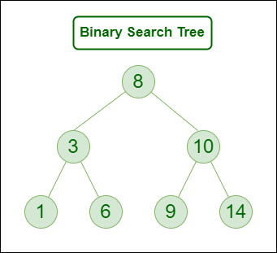

Slide 24
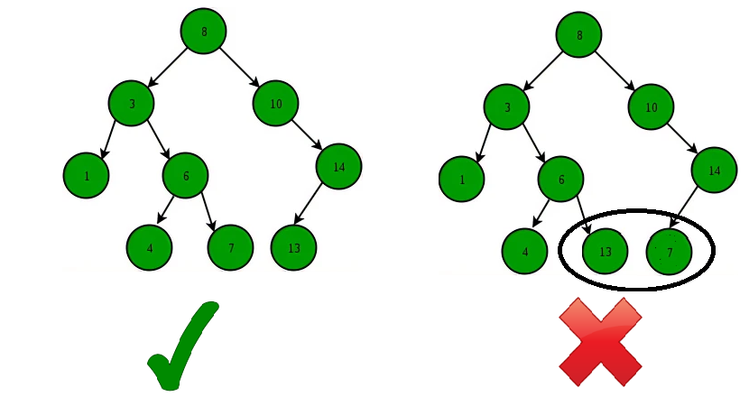

Slide 25
AVL Tree
AVL tree is a self-balancing binary search tree in which each node maintains extra information called a balance factor whose value is either -1, 0 or +1.
Operations on an AVL Tree:
Insertion
Deletion
Searching [It is similar to performing a search in BST]

Slide 26
Balance Factor = (Height of Left Subtree - Height of Right Subtree) or (Height of Right Subtree - Height of Left Subtree)
The self balancing property of an avl tree is maintained by the balance factor. The value of balance factor should always be -1, 0 or +1.

Slide 27
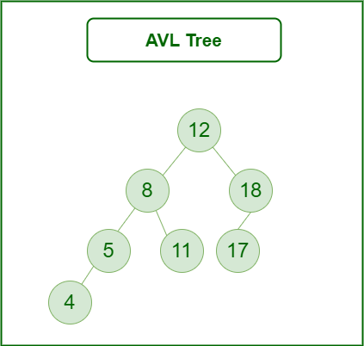

Slide 28
Applications of BST
A Self-Balancing Binary Search Tree is used to maintain sorted stream of data. For example, suppose we are getting online orders placed and we want to maintain the live data (in RAM) in sorted order of prices.
For example, we wish to know number of items purchased at cost below a given cost at any moment. Or we wish to know number of items purchased at higher cost than given cost.

Slide 29
B-Tree
A B-tree is a self-balancing tree where all the leaf nodes are at the same level which allows for efficient searching, insertion and deletion of records.
Because of all the leaf nodes being on the same level, the access time of data is fixed regardless of the size of the data set.

Slide 30
Applications of B-Trees
It is used in large databases to access data stored on the disk
Searching for data in a data set can be achieved in significantly less time using the B-Tree
With the indexing feature, multilevel indexing can be achieved.
Most of the servers also use the B-tree approach.
B-Trees are used in CAD systems to organize and search geometric data.
B-Trees are also used in other areas such as natural language processing, computer networks, and cryptography.

Slide 31
Advantages of B-Trees
B-Trees have a guaranteed time complexity of O(log n) for basic operations like insertion, deletion, and searching, which makes them suitable for large data sets and real-time applications.
B-Trees are self-balancing.
High-concurrency and high-throughput.
Efficient storage utilization.

Slide 32
Disadvantages of B-Trees
B-Trees are based on disk-based data structures and can have a high disk usage.
Not the best for all cases.
Slow in comparison to other data structures.
Insertion and Deletion: B-Tree Insertion B-Tree Deletion

Slide 33
Graph
A Graph is a non-linear data structure consisting of vertices and edges. The vertices are sometimes also referred to as nodes and the edges are lines or arcs that connect any two nodes in the graph. More formally a Graph is composed of a set of vertices( V ) and a set of edges( E ). The graph is denoted by G(V, E).
Graph data structures are a powerful tool for representing and analyzing complex relationships between objects or entities.

Slide 34
They are particularly useful in fields such as
Social Network analysis
Recommendation systems, and computer networks.
In the field of sports data science, graph data structures can be used to analyze and understand the dynamics of team performance and player interactions on the field.

Slide 35
Components of a Graph
Vertices: Vertices are the fundamental units of the graph. Sometimes, vertices are also known as vertex or nodes. Every node/vertex can be labeled or unlabelled.
Edges: Edges are drawn or used to connect two nodes of the graph. It can be ordered pair of nodes in a directed graph. Edges can connect any two nodes in any possible way. There are no rules. Sometimes, edges are also known as arcs. Every edge can be labelled/unlabelled.

Slide 36
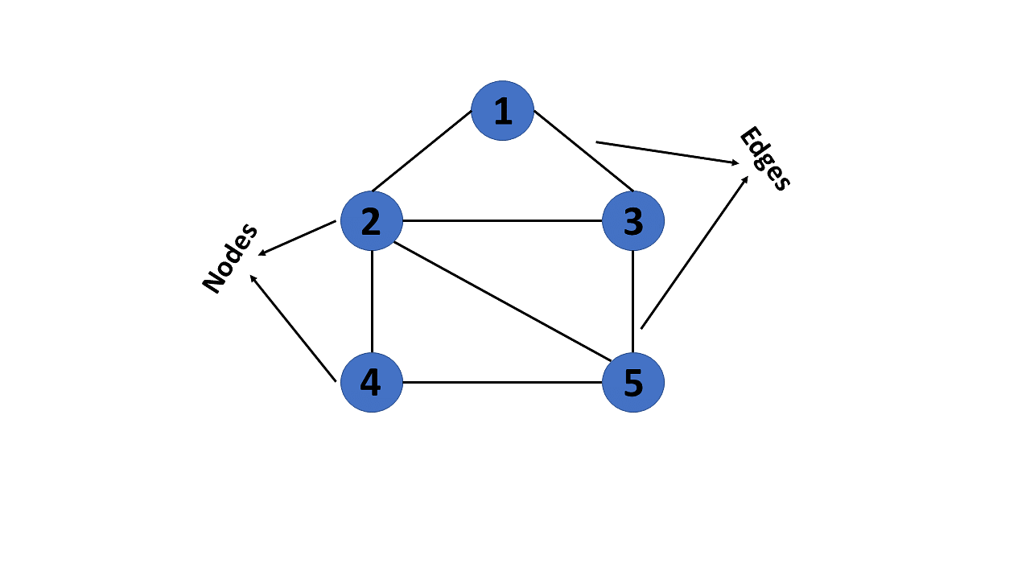

Slide 37
Types Of Graph
1. Null Graph
A graph is known as a null graph if there are no edges in the graph.
2. Trivial Graph
Graph having only a single vertex, it is also the smallest graph possible.

Slide 38
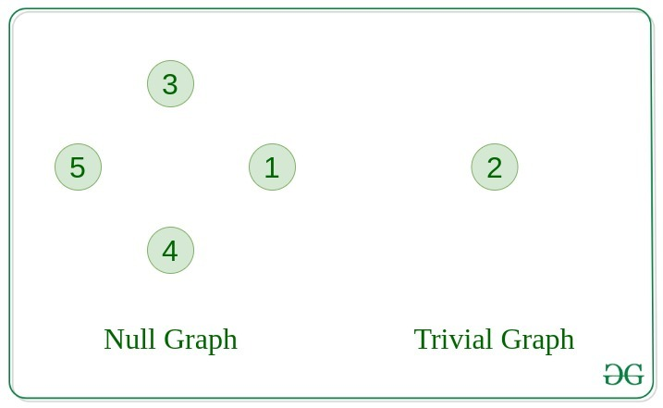

Slide 39
3. Undirected Graph
A graph in which edges do not have any direction. That is the nodes are unordered pairs in the definition of every edge.
4. Directed Graph
A graph in which edge has direction. That is the nodes are ordered pairs in the definition of every edge.

Slide 40
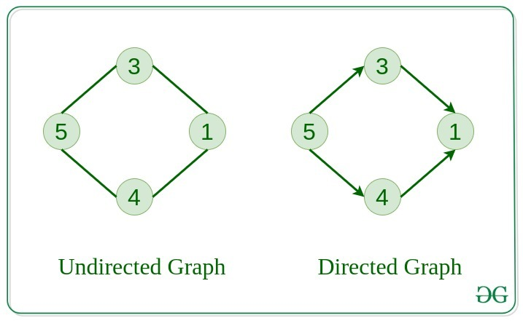

Slide 41
Representation of Graphs
There are two ways to store a graph:
Adjacency Matrix
Adjacency List

Slide 42
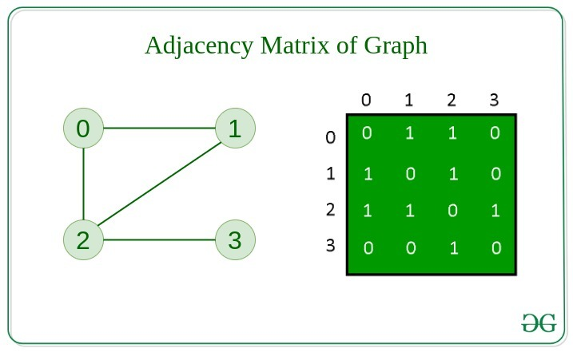
Adjacency Matrix
In this method, the graph is stored in the form of the 2D matrix where rows and columns denote vertices. Each entry in the matrix represents the weight of the edge between those vertices.

Slide 43
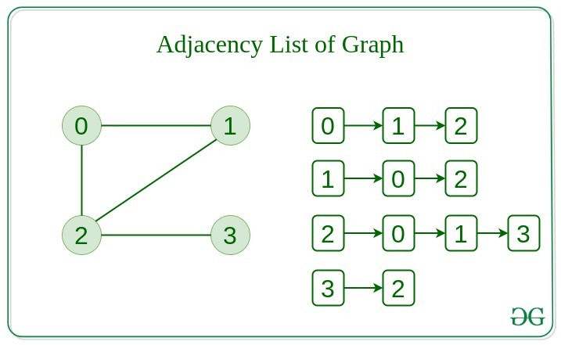
Adjacency List
This graph is represented as a collection of linked lists. There is an array of pointer which points to the edges connected to that vertex.

Slide 44
Real-Time Applications of Graph:
Social media analysis: Social media platforms generate vast amounts of data in real-time, which can be analyzed using graphs to identify trends, sentiment, and key influencers. This can be useful for marketing, customer service, and reputation management.
Network monitoring: Graphs can be used to monitor network traffic in real-time, allowing network administrators to identify potential bottlenecks, security threats, and other issues. This is critical for ensuring the smooth operation of complex networks.

Slide 45
Financial trading: Graphs can be used to analyze real-time financial data, such as stock prices and market trends, to identify patterns and make trading decisions. This is particularly important for high-frequency trading, where even small delays can have a significant impact on profits.
Internet of Things (IoT) management: IoT devices generate vast amounts of data in real-time, which can be analyzed using graphs to identify patterns, optimize performance, and detect anomalies. This is important for managing large-scale IoT deployments.

Slide 46
Advantages of Graph
Representing complex data: Graphs are effective tools for representing complex data, especially when the relationships between the data points are not straightforward. They can help to uncover patterns, trends, and insights that may be difficult to see using other methods.
Efficient data processing: Graphs can be processed efficiently using graph algorithms, which are specifically designed to work with graph data structures. This makes it possible to perform complex operations on large datasets quickly and effectively.

Slide 47
Network analysis: Graphs are commonly used in network analysis to study relationships between individuals or organizations, as well as to identify important nodes and edges in a network. This is useful in a variety of fields, including social sciences, business, and marketing.
Pathfinding: Graphs can be used to find the shortest path between two points, which is a common problem in computer science, logistics, and transportation planning.

Slide 48
Disadvantages of Graph
Limited representation: Graphs can only represent relationships between objects, and not their properties or attributes. This means that in order to fully understand the data, it may be necessary to supplement the graph with additional information.
Difficulty in interpretation: Graphs can be difficult to interpret, especially if they are large or complex. This can make it challenging to extract meaningful insights from the data, and may require advanced analytical techniques or domain expertise.
Scalability issues: As the number of nodes and edges in a graph increases, the processing time and memory required to analyze it also increases. This can make it difficult to work with large or complex graphs.

